Slide 1
Data Analysis Internship Project Report
Presenter: Gavic Bikku George
Guide: Ms. Ashvitha Dominic
Host Organization: Tamil Nadu Smart and Advanced Manufacturing
Center (TANSAM)
Date: June 9, 2026

Slide 2
Core Challenge:
Transforming Fragmented Data into Actionable Strategy

Slide 3
Primary Project Objectives:
1. Programmatic Data Scrubbing: Leverage Python to clean raw transaction fields and enforce uniform data types. 2. Relational Database Storage: Establish a centralized, secure relational repository within PostgreSQL for fast querying and data integrity. 3. Interactive BI Deployment: Construct an executive-facing Power BI dashboard to serve as the organization's single source of truth for corporate strategy.

Slide 4
Strategic Component Rationalization
Strategic Component Rationalization
Pipeline Tier | Technology Selected | Core Functional Purpose
Tier 1: Data Engine | Python ,Pandas , Numbpy, Seaborn, (in Google Colab and Anaconda Jupiter) | Statistical anomaly profiling, handling missing fields, and deterministic text alignment, statistical calculation and visualization
Tier 2: Storage | PostgreSQL Server & pgAdmin | Centralized tables, referential data integrity, and fast SQL analytical execution.
Tier 3: Analytics | Power BI Desktop | Live database semantic mapping, interactive cross-filtering, and executive delivery.

Slide 5
Tier 1: Data Engine
Structural Inspections: Executed .shape to determine overall matrix size, combined with .head(), .tail(), and .info() to profile column data types and structural integrity.
Null Vector Remediation: Deployed .isnull().sum() to pinpoint missing inputs. Resolved missing values via .fillna() using .mean() for standard distributions and .median() to prevent outlier distortion.

Slide 6
Tier 1: Data Engine
Lexical Standardization: Applied .str.lower(), .str.upper(), and .str.title() across text strings to eliminate categorical duplication caused by random casing (e.g., merging "clothing" and "Clothing")
Deduplication Guardrails: Applied .drop_duplicates() to remove inflationary records, ensuring that baseline transaction counts and customer metrics remained perfectly accurate.

Slide 7
Production Code Snippet:
import pandas as pd
import numpy as np
# Ingest raw transaction dataset as documented in "Customer Behaviour Analysis.pdf"
df = pd.read_csv('/content/sampledata2.csv’)
# Audit structural dimensions and locate missing data
print(f"Initial Shape: {df.shape}")
print(df.isnull().sum())

Slide 8
Production Code Snippet: (continue..)
# Text Standardization: Eradicate mismatched categorical naming conventions
df['Category'] = df['Category'].str.title()
df['Item Purchased'] = df['Item Purchased'].str.title()
print(f"Cleaned Post-Processing Shape: {df.shape}“)
df.head()

Slide 9
Production Code Snippet: (continue..)
# Clean specific transactional blocks by mapping or removing unnecessary tracking code
if 'promo_code_used' in df.columns:
df.drop(columns=['promo_code_used'], inplace=True)
# Deduplicate to protect baseline metrics
df.drop_duplicates(inplace=True)

Slide 10
Production Code Snippet: (continue..)
# Demographically slice consumer base using quantile-based categorization
df['age_group'] = pd.qcut(df['Age'], q=4, labels=['Young Adult', 'Middle Aged', 'Adult', 'Senior'])

Slide 11
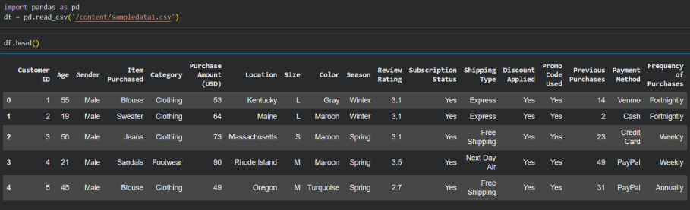
Production Code Snippet: (continue..)

Slide 12
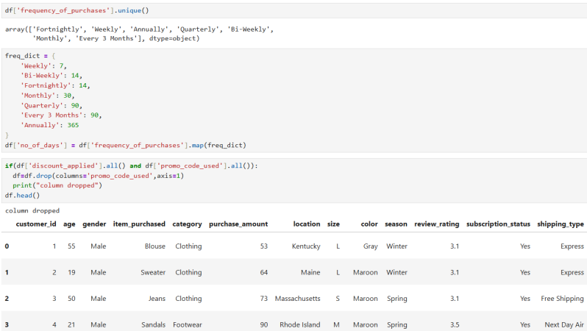
Production Code Snippet: (continue..)

Slide 13
Tier 2: Storage (Relational Query Execution (SQL))
Query Logic & Rationale
To discover exactly which items generate the highest customer demand across specific categories, we run a high-performance SQL query. This query utilizes an internal Window Function (ROW_NUMBER() OVER(PARTITION BY...)) to dynamically count and rank items by purchase popularity within their parent business categories.

Slide 14
Tier 2: Storage (Relational Query Execution (SQL))
Query Logic & Rationale
To discover exactly which items generate the highest customer demand across specific categories, we run a high-performance SQL query. This query utilizes an internal Window Function (ROW_NUMBER() OVER(PARTITION BY...)) to dynamically count and rank items by purchase popularity within their parent business categories.

Slide 15
SQL Code Snippet: (continue)
WITH ProductCounts AS (
SELECT
Category,
Item_Purchased,
COUNT(*) AS Purchase_Count,
ROW_NUMBER() OVER (
PARTITION BY Category
ORDER BY COUNT(*) DESC
) AS Row_Num

Slide 16
SQL Code Snippet: (continue)
FROM
customers
GROUP BY
Category,
Item_Purchased
)
SELECT
Category,
Item_Purchased,
Purchase_Count
FROM
ProductCounts
WHERE
Row_Num <= 3;

Slide 17
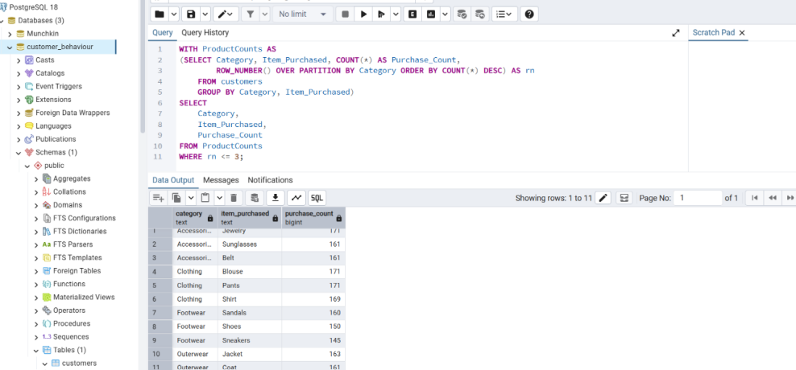
SQL Code Snippet: (continue)

Slide 18
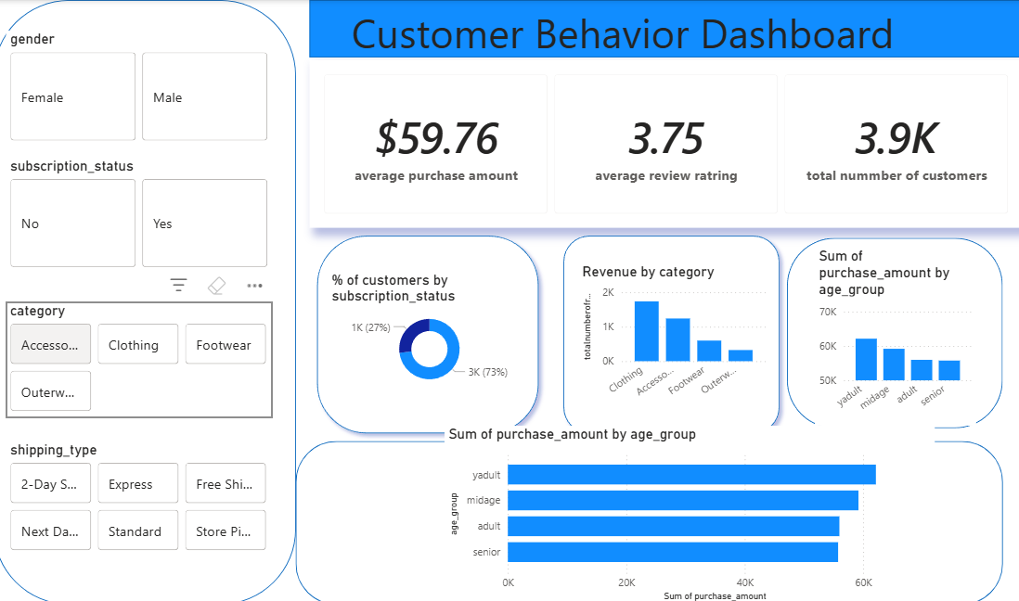
Tier 3: Power BI Desktop

Slide 19
Visualization using Seaborn
Univariate Distribution Insights: Utilizing high-density Histograms (sns.boxplot) and data spread plots to evaluate underlying skewness and volume counts
Multivariate Interaction Modeling: Applying comprehensive correlation Heatmaps (sns.heatmap) and relational Pair Plots (sns.pairplot) to track multi-variable relationships across the entire system.

Slide 20
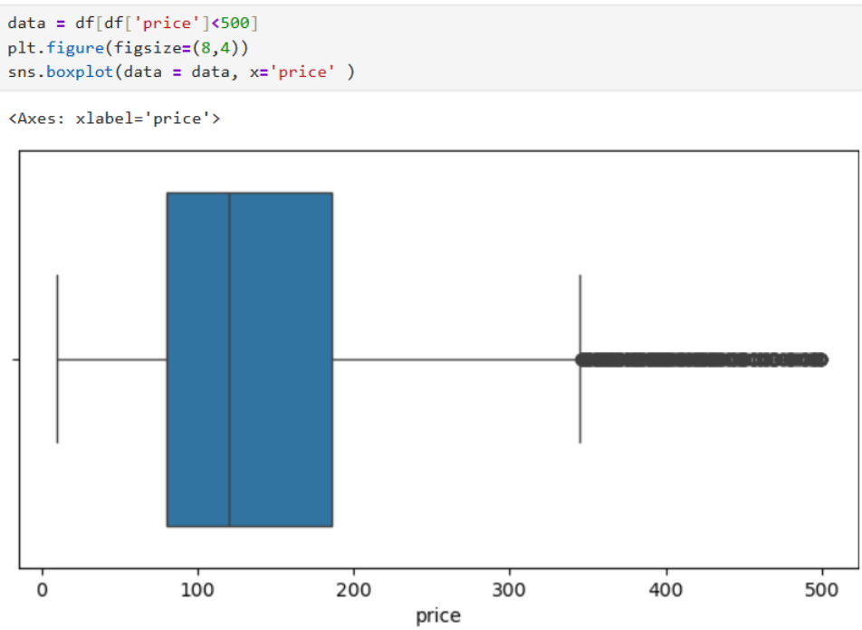
Ex. Of Boxplot,Histplot, Pairplot, Heatmap

Slide 21
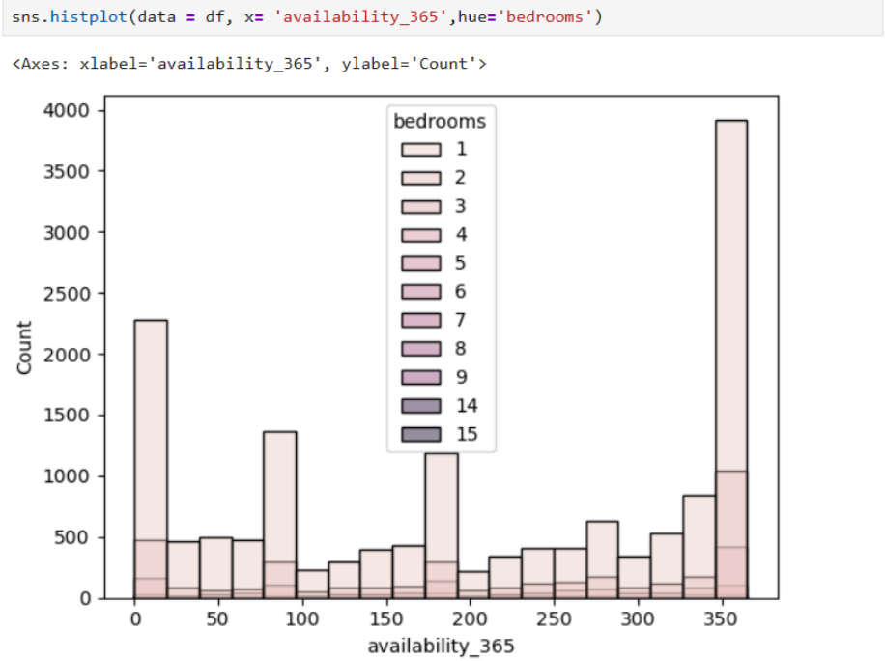
Ex. Of Hisplot, Pairplot, Heatmap

Slide 22
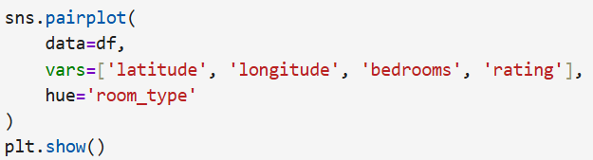
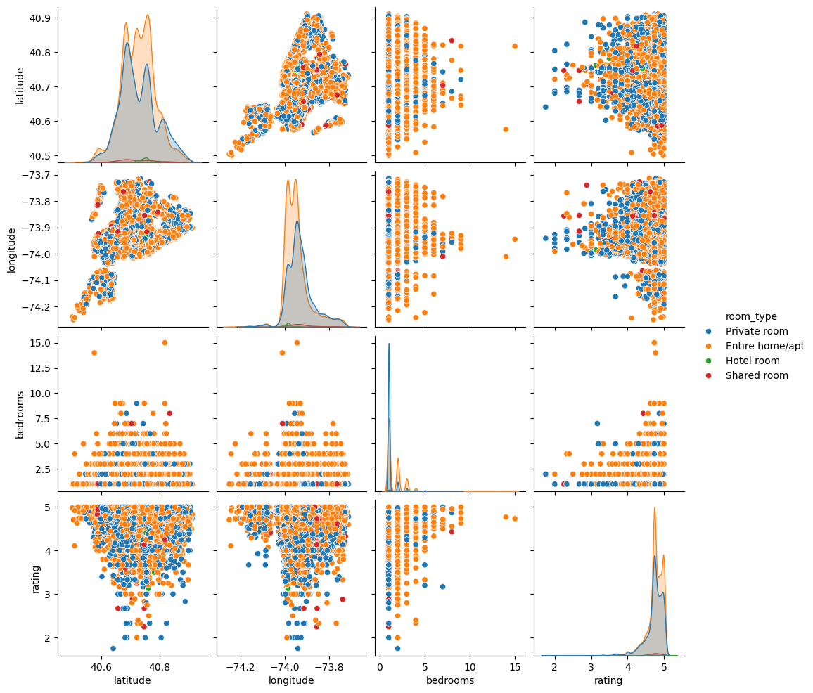

Slide 23
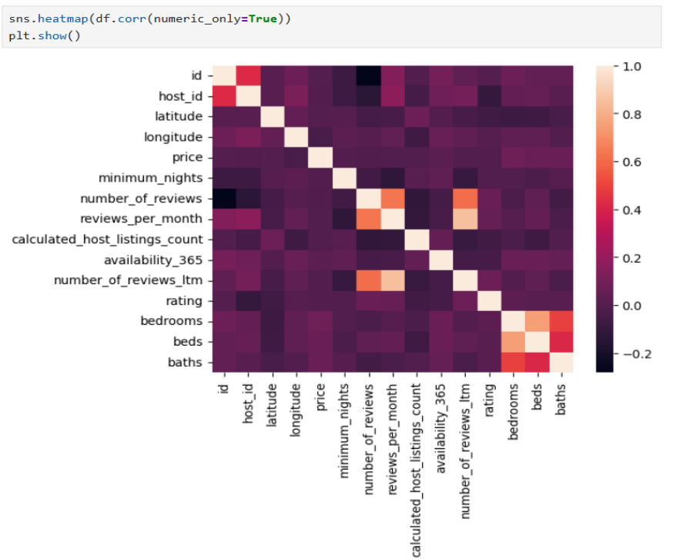

Slide 24
Analytical Findings: Categories & Demographics
Observation 1: Core Revenue Engines Insight: Sales data proves that the Clothing segment stands as the company's clear primary revenue driver. Secondary Drivers: Accessories hold a strong second place, while Footwear and Outerwear account for a significantly lower share of revenue. Business Implication: Inventory budgets, store layout space, and product variety should prioritize Clothing and Accessories to maximize overall margins.

Slide 25
Analytical Findings: Categories & Demographics (continue..)
Observation 2: Demographic Purchasing Power Insight: Age distribution analysis shows that the Young Adult group contributes the highest overall purchase spending. Lowest Performers: The Senior demographic represents the smallest portion of active spending. Business Implication: Brand marketing campaigns and digital advertisements should be heavily tailored to match the unique styles and buying preferences of the high-value Young Adult demographic.

Slide 26
Analytical Findings: Subscriptions & Logistics
Observation 1: The Subscription Deficit Insight: Customer classification metrics show a major structural imbalance: the vast majority of active buyers are Non-Subscribers. The Minority Segment: Registered subscribers represent only a small fraction of our baseline customer map. Business Implication: The current business baseline depends heavily on one-off transactions. This represents a massive opportunity to build loyalty programs that secure recurring revenue.

Slide 27
Analytical Findings: Subscriptions & Logistics
Observation 1: The Subscription Deficit Insight: Customer classification metrics show a major structural imbalance: the vast majority of active buyers are Non-Subscribers. The Minority Segment: Registered subscribers represent only a small fraction of our baseline customer map. Business Implication: The current business baseline depends heavily on one-off transactions. This represents a massive opportunity to build loyalty programs that secure recurring revenue.

Slide 28
Analytical Findings: Subscriptions & Logistics (continue..)
Observation 2: Purchase Frequency Impact Insight: Timeline tracking shows that buyers ordering on an Every 3 Months frequency generate our highest total spending volume, with Monthly shoppers following as the second most active group. Business Implication: Designing promotions that incentivize casual three-month buyers to move into a predictable, monthly purchase cycle will dramatically improve monthly cash flow stability.

Slide 29
Core Insights Driving Retail Performance
Top Sales Category: Clothing consistently leads the company in overall sales volume and revenue generation.
Key Demographic Driver: Young adults represent the primary demographic engine for overall sales growth.
Predictable Basket Size: The average transaction amount remains steady at approximately $59.76.
Stable Customer Satisfaction: Brand quality scores hold at an average 3.75 out of 5.00, indicating steady customer satisfaction with clear room to grow.
Subscription Growth Opportunity: Non-subscribers make up the vast majority of our buyers, meaning we must prioritize building a recurring subscriber base.

Slide 30
Strategic Plan: Maximizing Customer Value and Core Categories
Proposed Strategic Action | Supporting Data Evidence / Rationale | Corporate Priority
Convert Casual Buyers to Subscribers | Non-subscribers dominate current sales volume, while repeat buyers purchase every 3 months, creating a stable revenue base. Introduce subscription incentives to convert recurring customers into predictable monthly subscribers. | 🔴 HIGH

Slide 31
Strategic Plan: Maximizing Customer Value and Core Categories
Proposed Strategic Action | Supporting Data Evidence / Rationale | Corporate Priority
Align Inventory & Marketing Spend | Clothing and Accessories are the strongest-performing categories. Young Adults represent the highest-spending customer segment. Focus inventory planning and marketing campaigns on these high-value areas. | 🔴 HIGH

Slide 32
Strategic Plan: Maximizing Customer Value and Core Categories
Proposed Strategic Action | Supporting Data Evidence / Rationale | Corporate Priority
Optimize Premium Shipping Promotions | Customers selecting Express/Next-Day shipping tend to have larger basket sizes. Implement free-shipping thresholds to encourage higher order values and increase average transaction size. | 🟡 MEDIUM

Slide 33
Thank You

